Slide 1
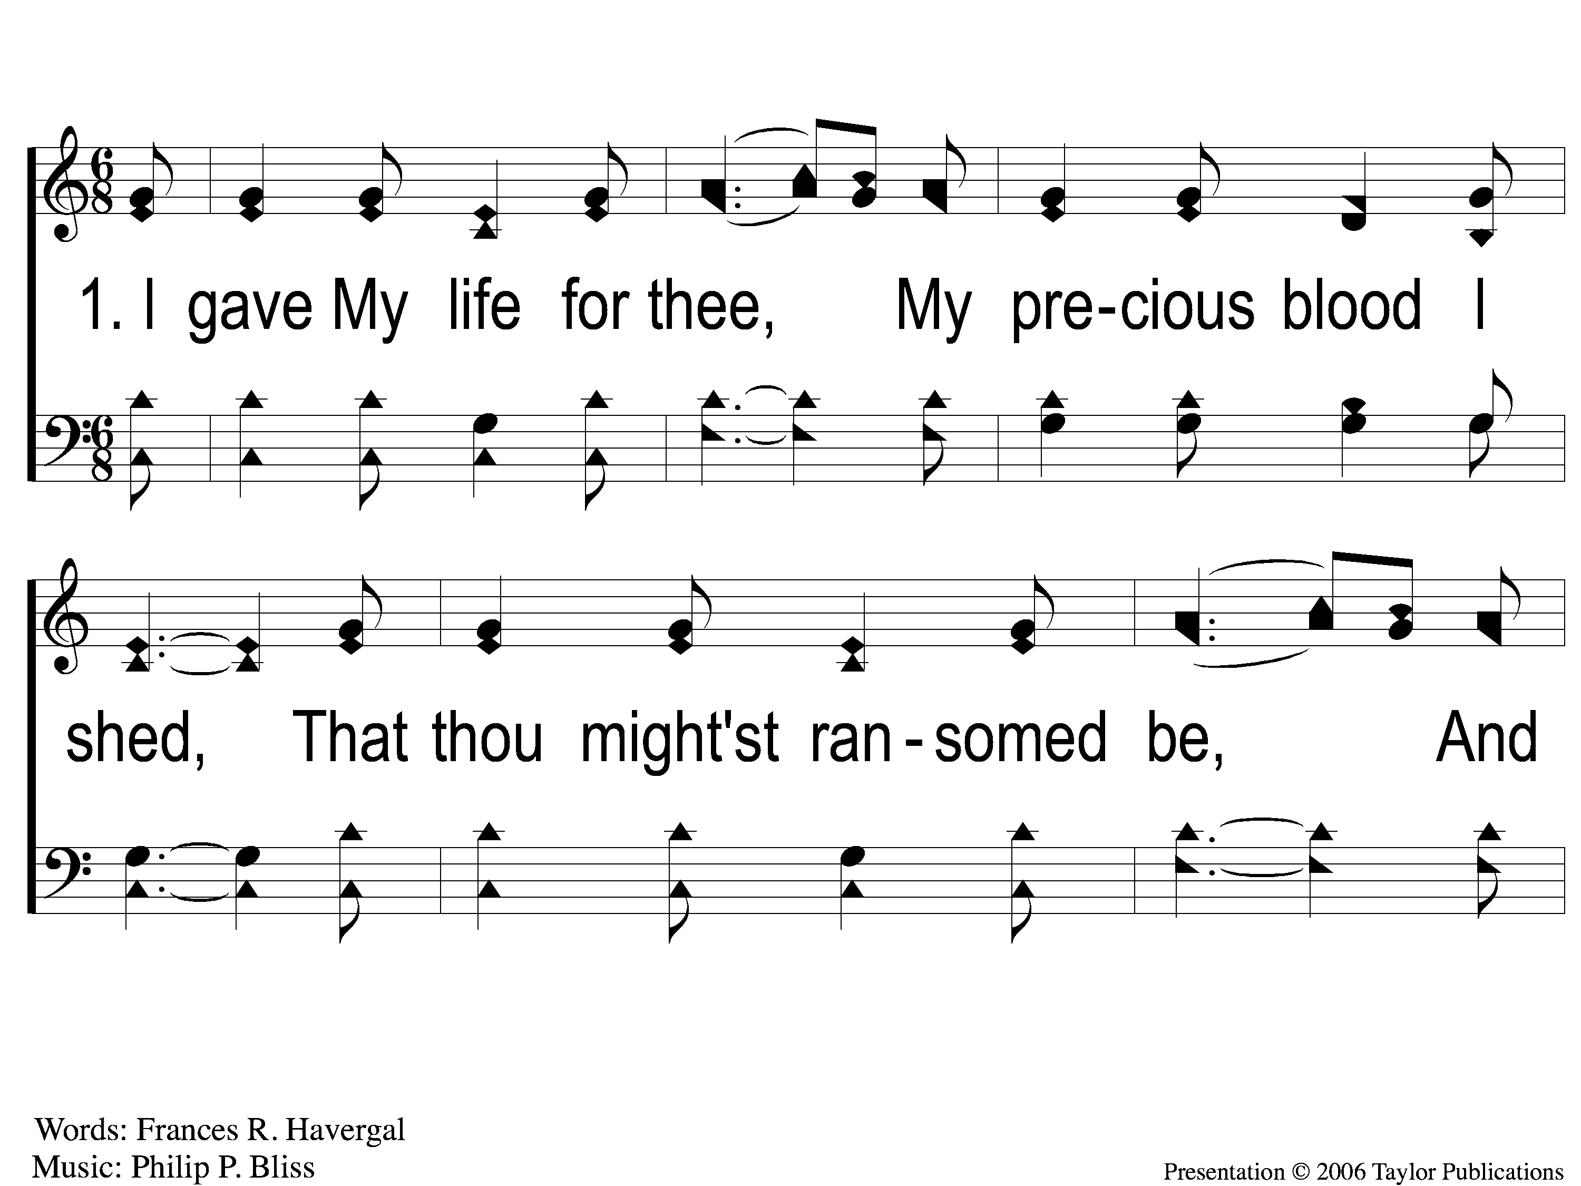
1-1 I Gave My Life For Thee
I Gave My Life for Thee
159

Slide 2
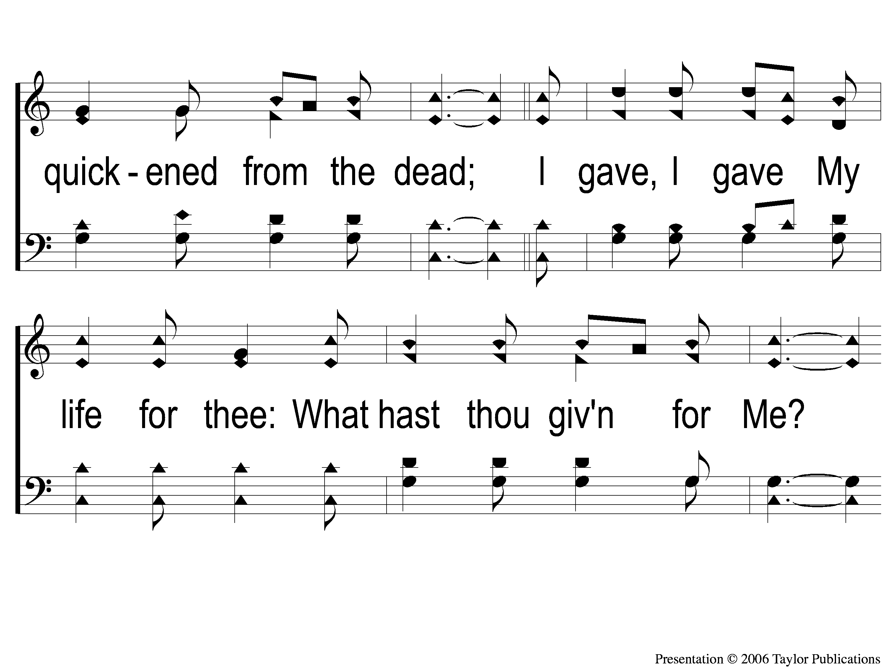
1-2 I Gave My Life For Thee
I Gave My Life for Thee
159

Slide 3
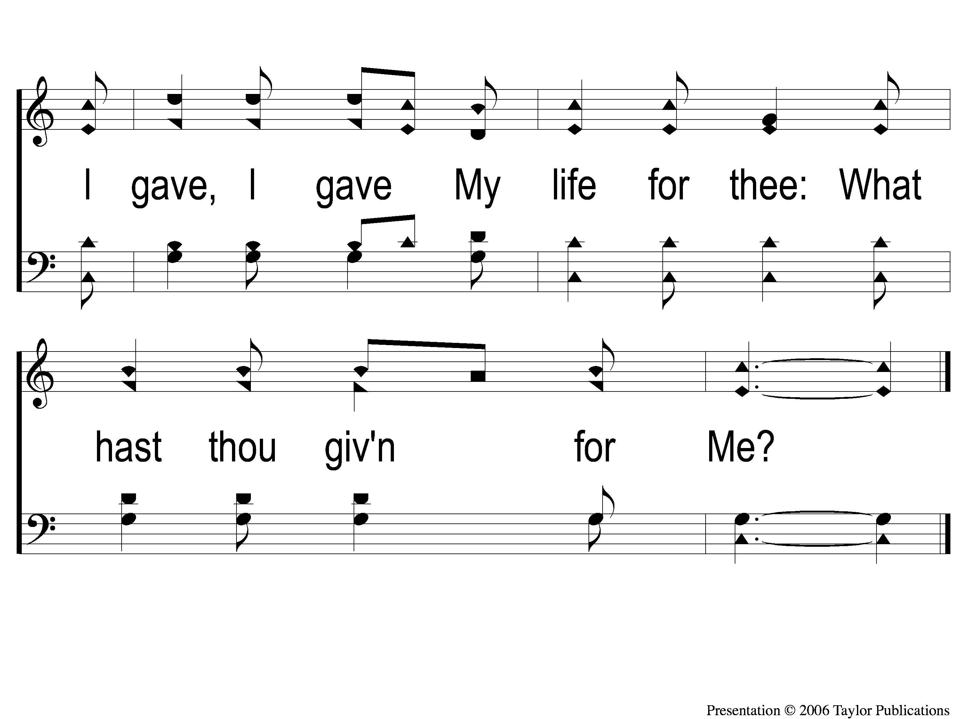
1-3 I Gave My Life For Thee
I Gave My Life for Thee
159

Slide 4
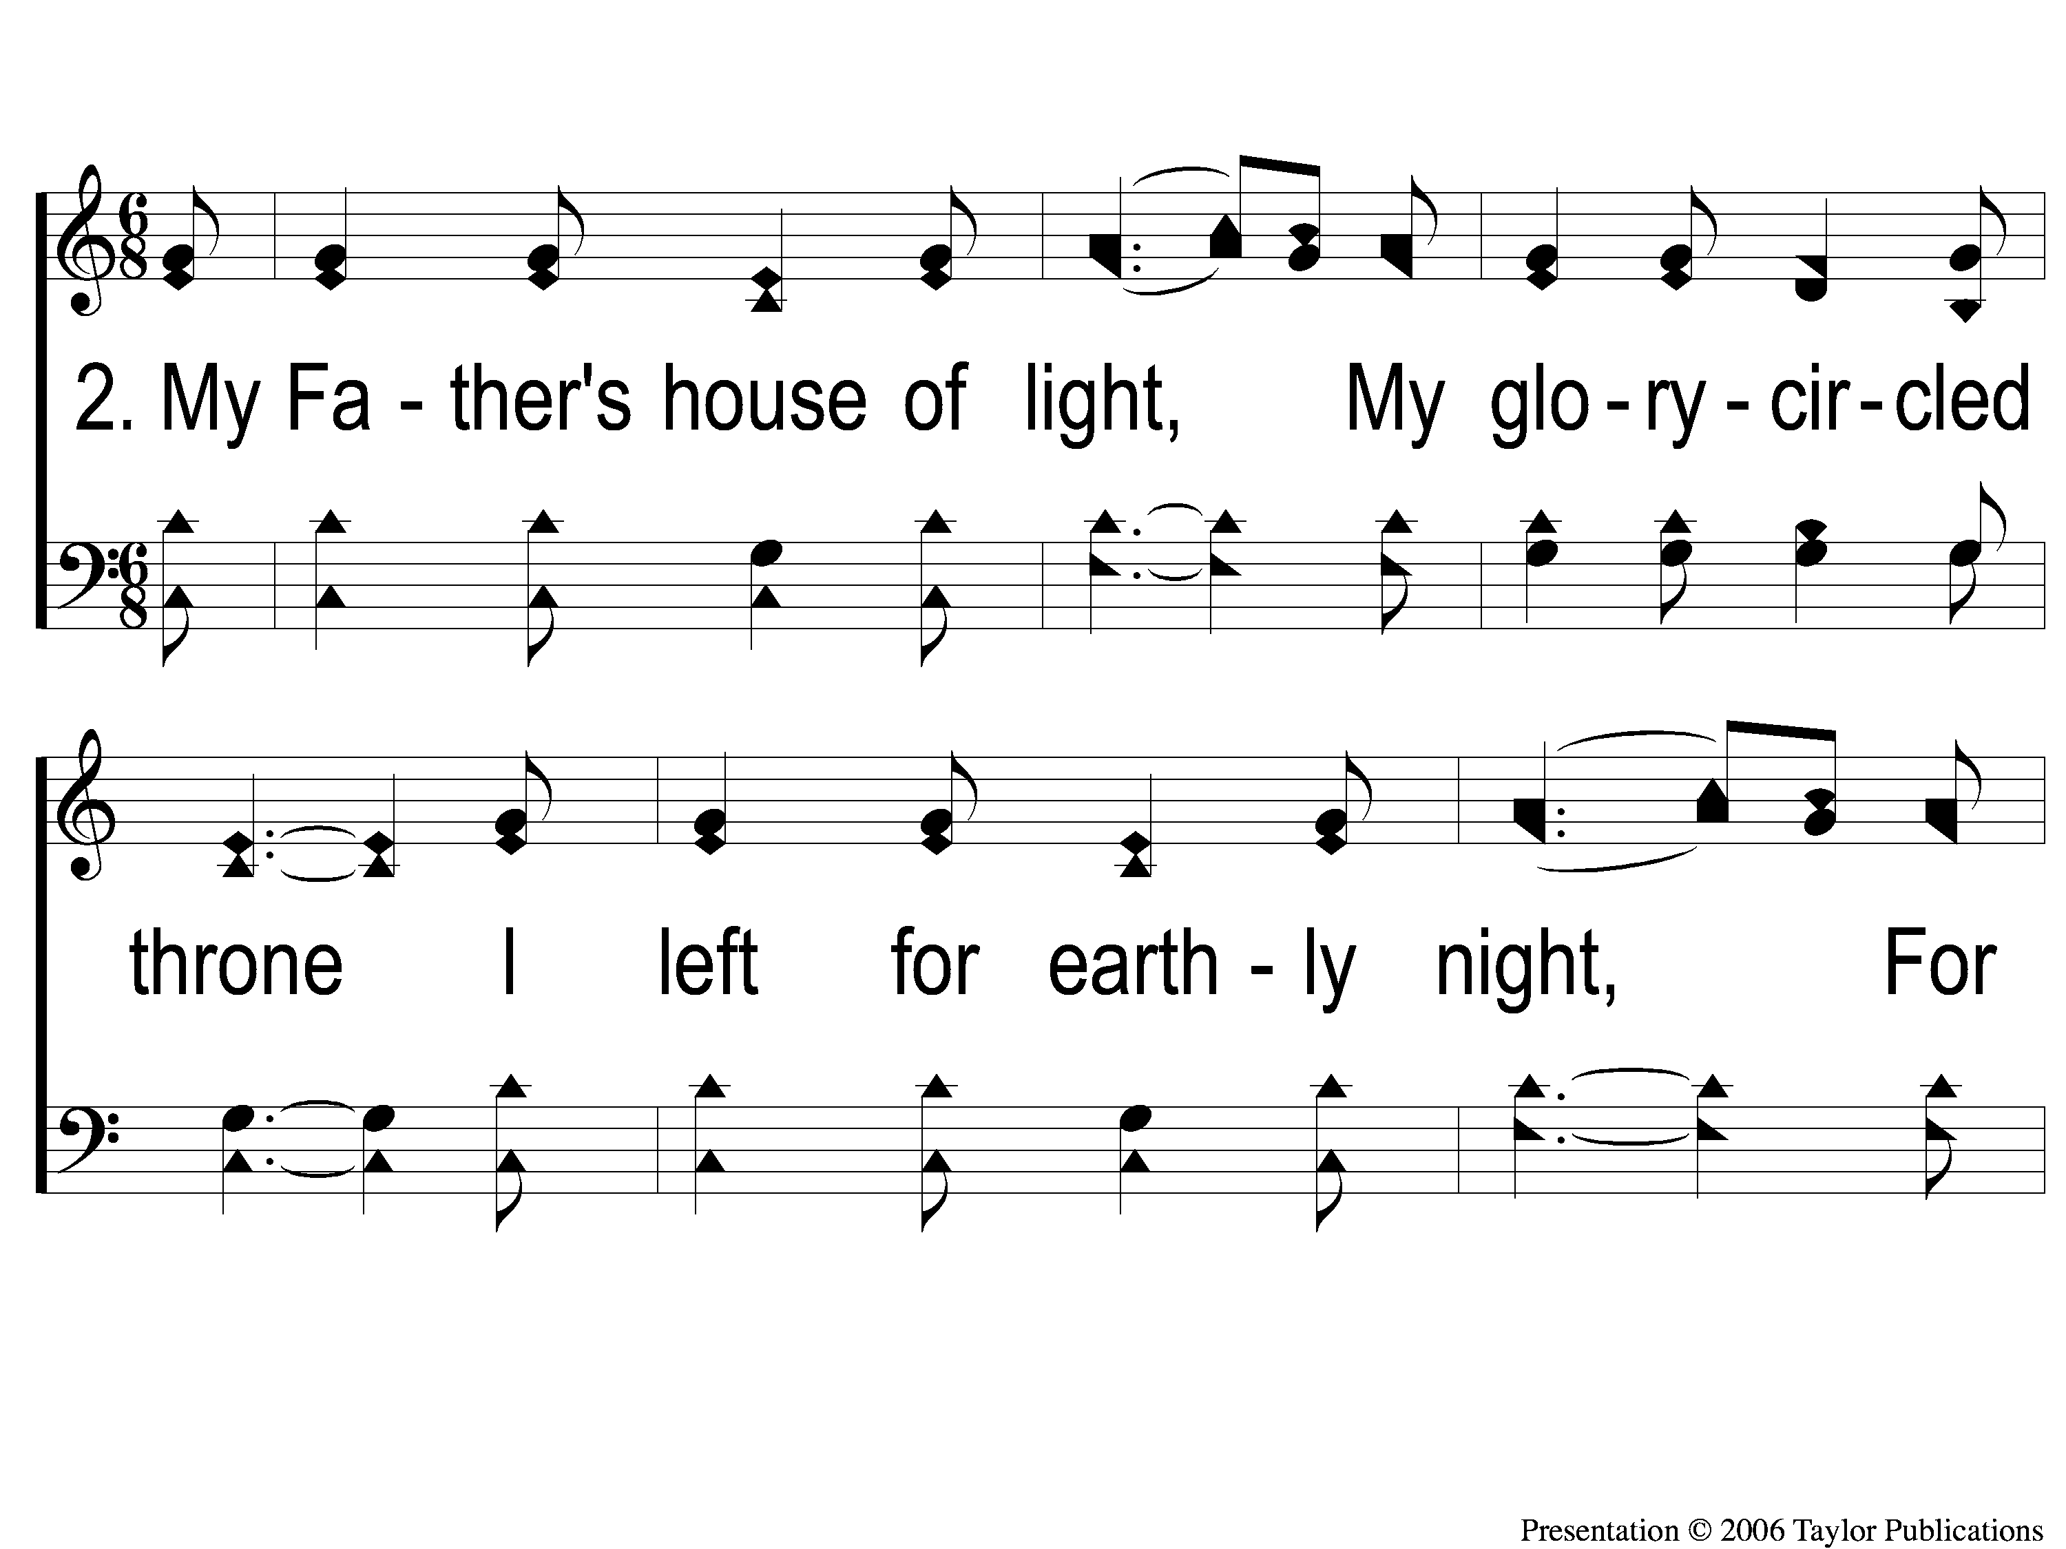
2-1 I Gave My Life For Thee
I Gave My Life for Thee
159

Slide 5
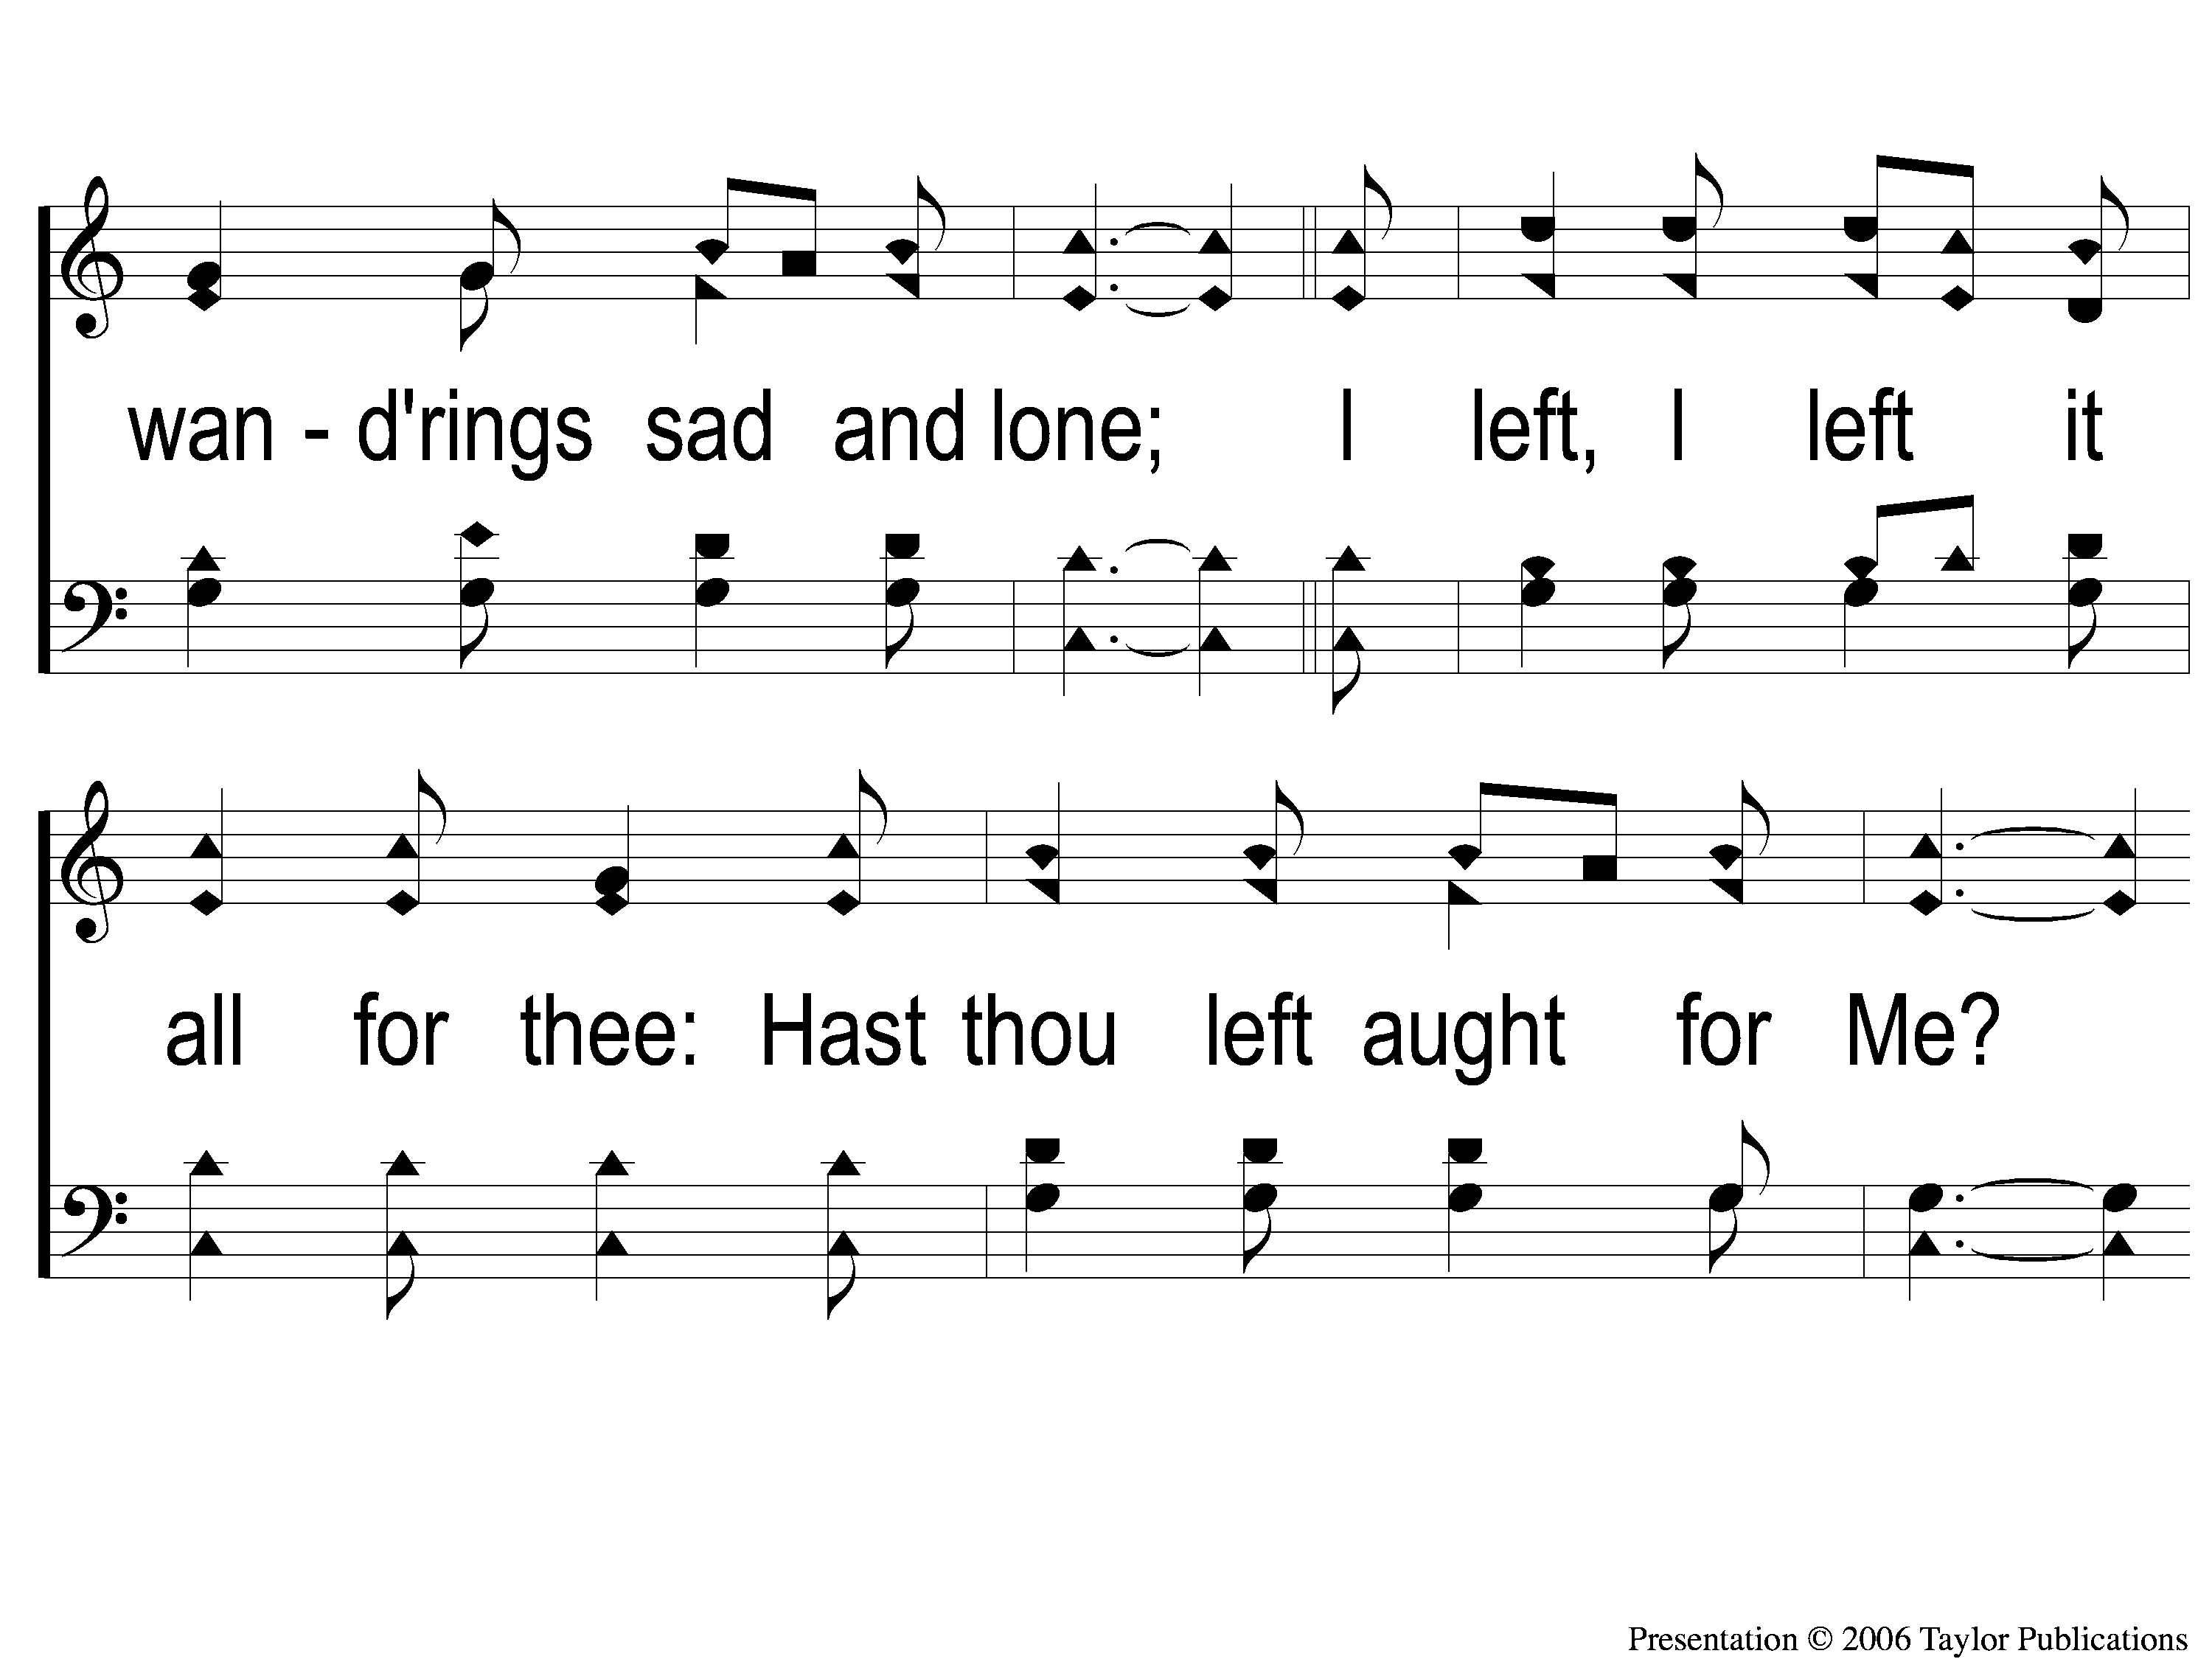
2-2 I Gave My Life For Thee
I Gave My Life for Thee
159

Slide 6
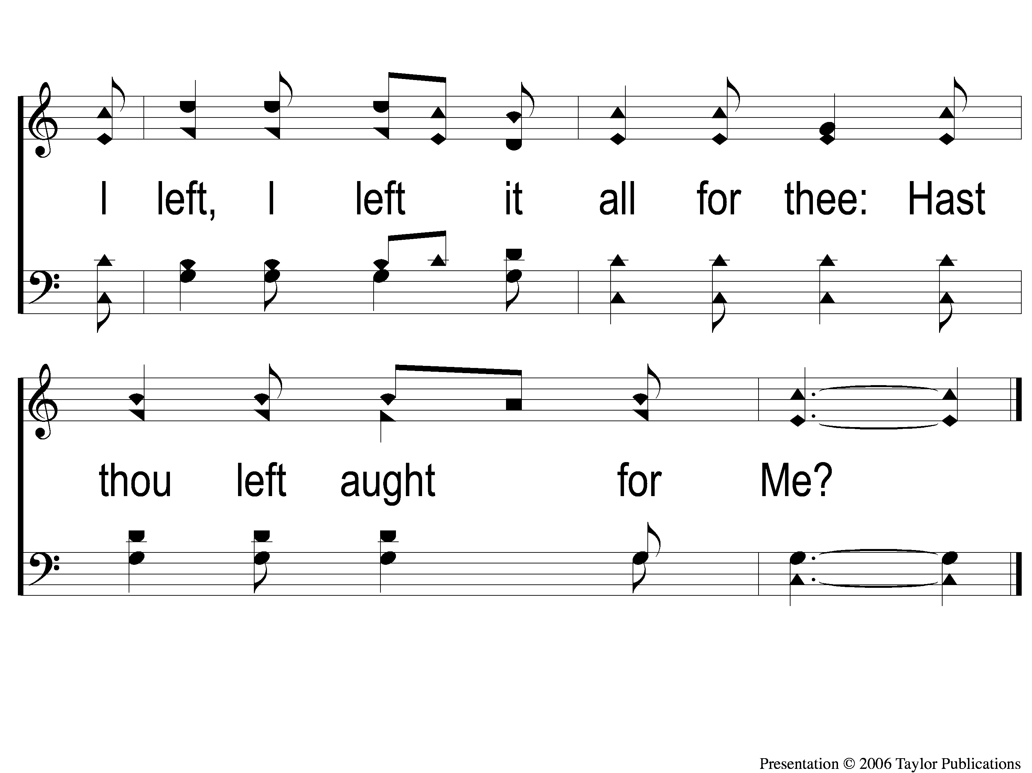
2-3 I Gave My Life For Thee
I Gave My Life for Thee
159

Slide 7
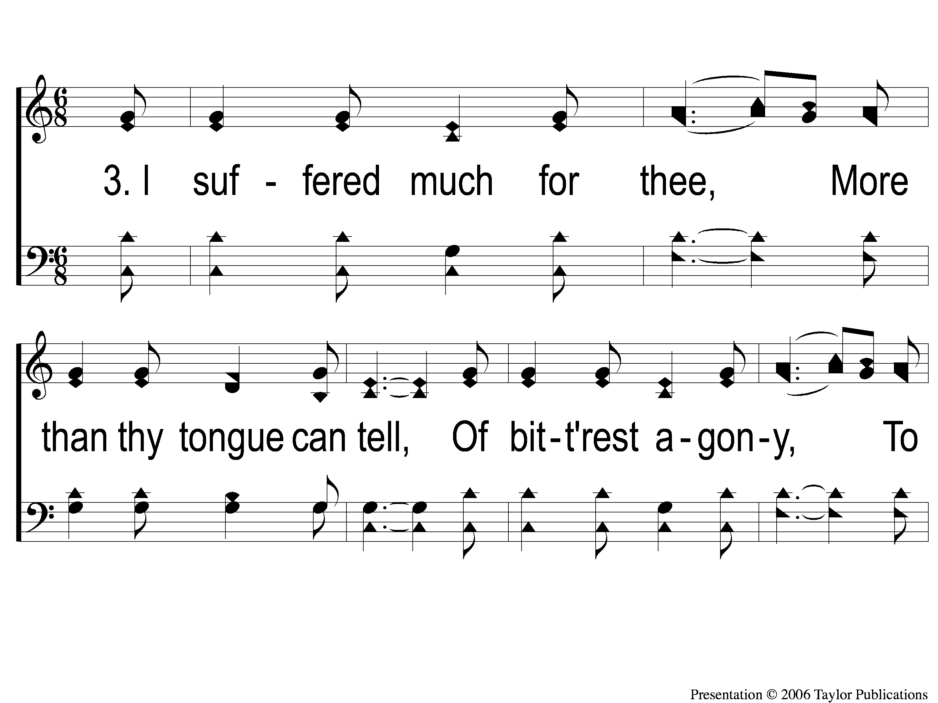
3-1 I Gave My Life For Thee
I Gave My Life for Thee
159

Slide 8
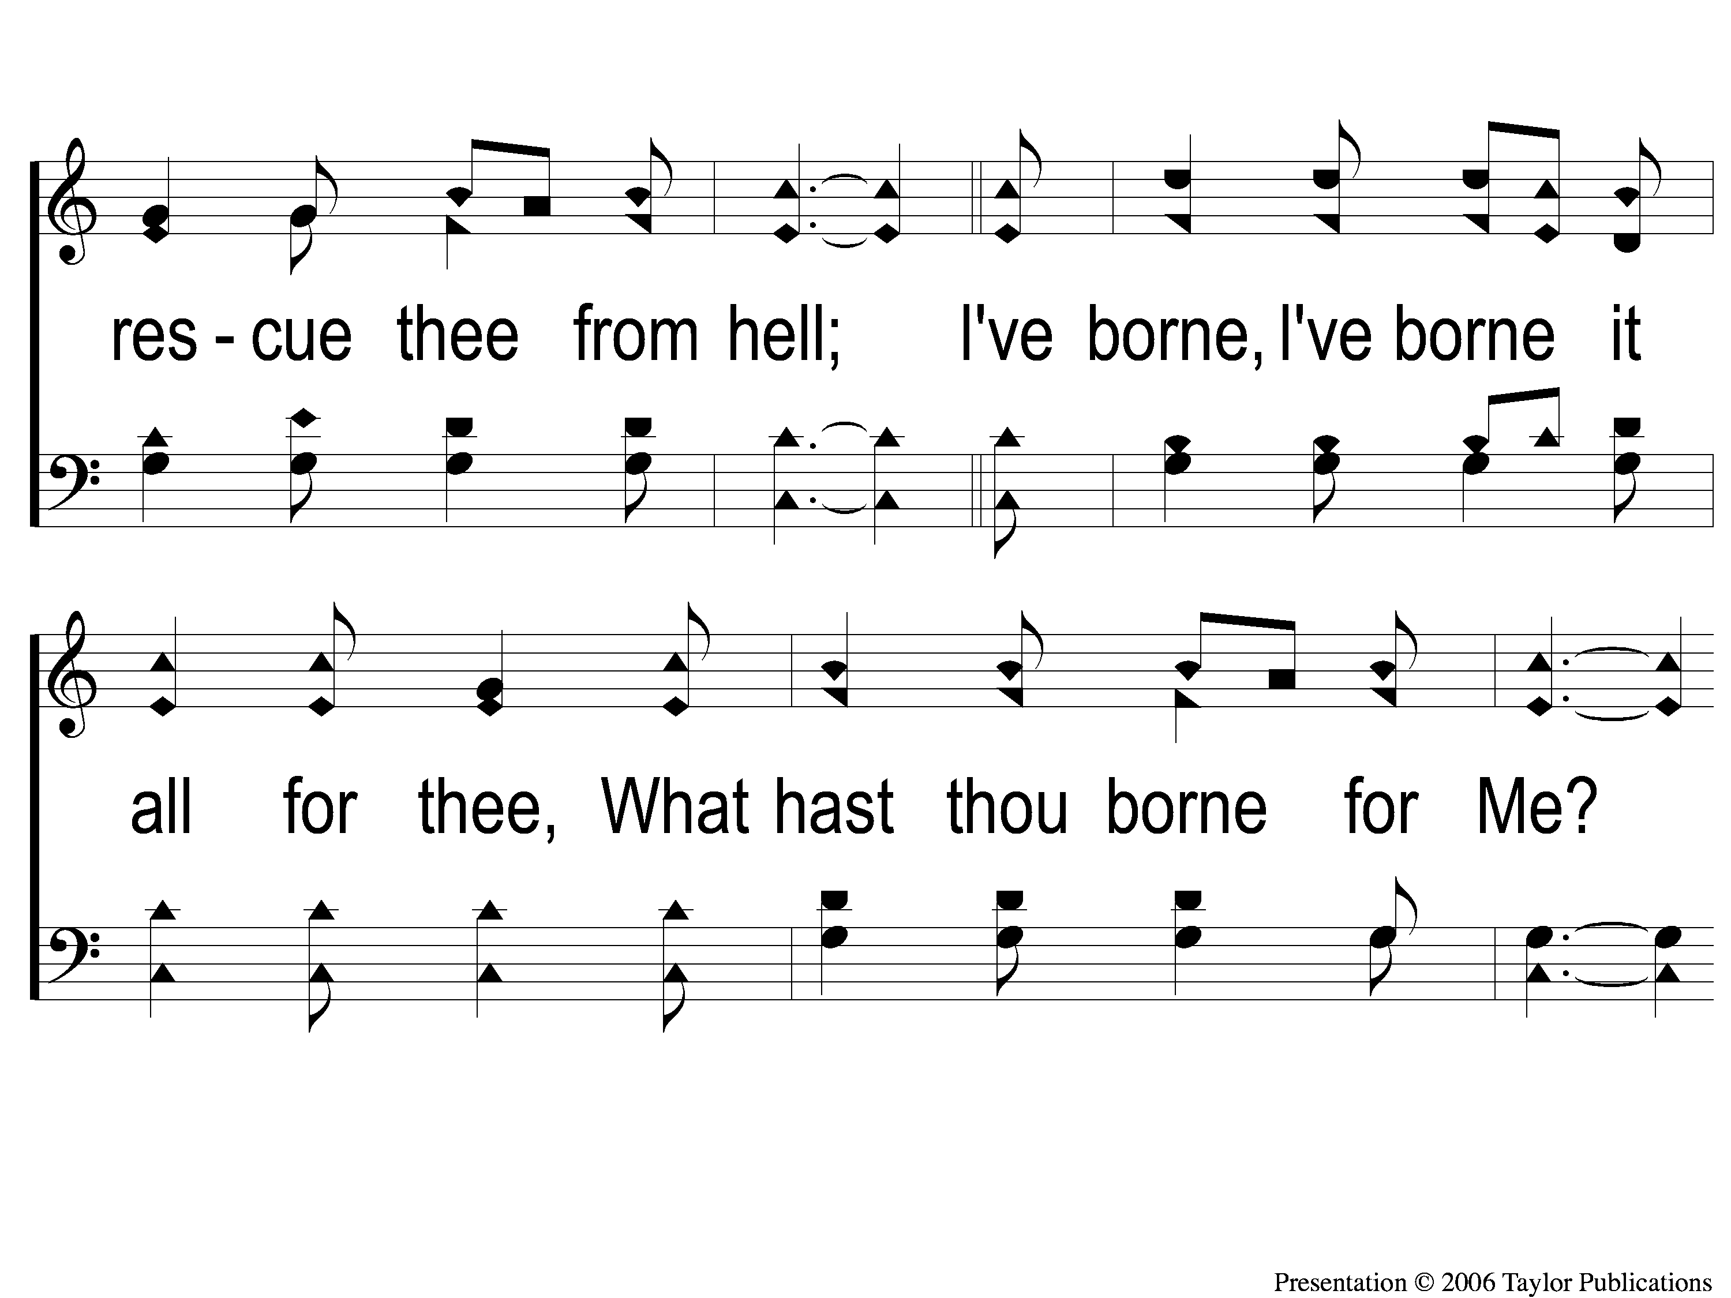
3-2 I Gave My Life For Thee
I Gave My Life for Thee
159

Slide 9
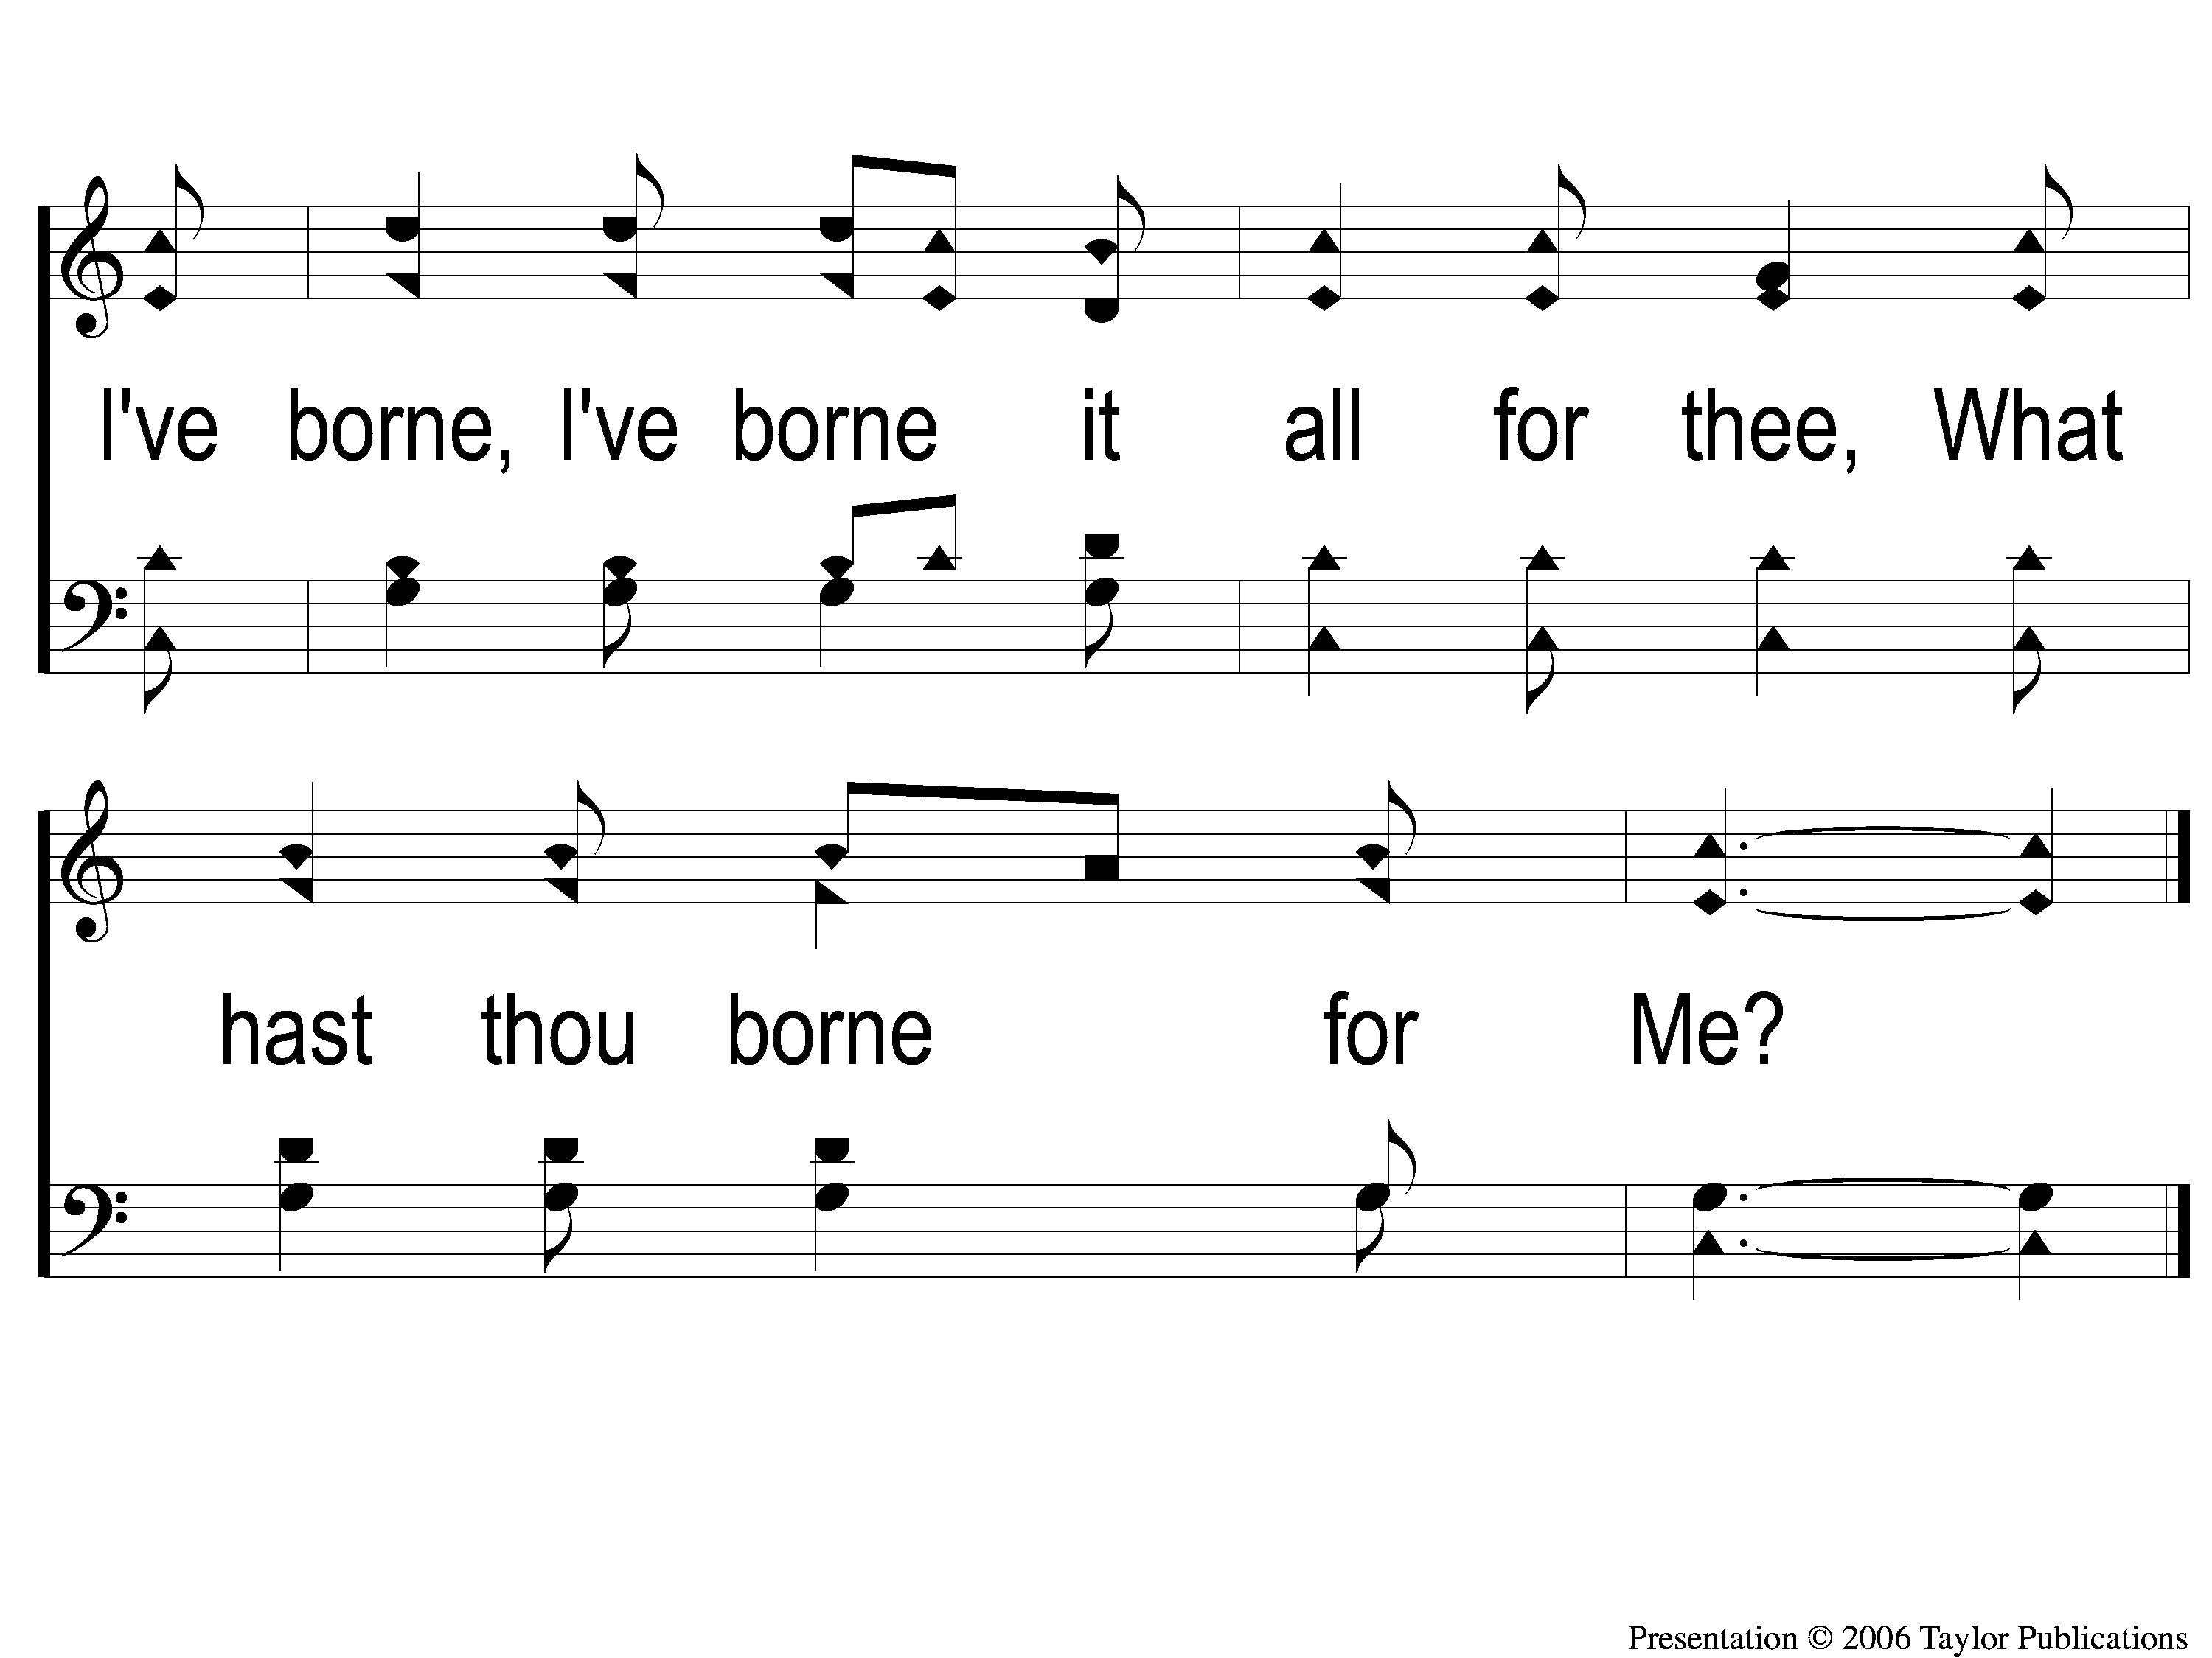
3-3 I Gave My Life For Thee
I Gave My Life for Thee
159

Slide 10
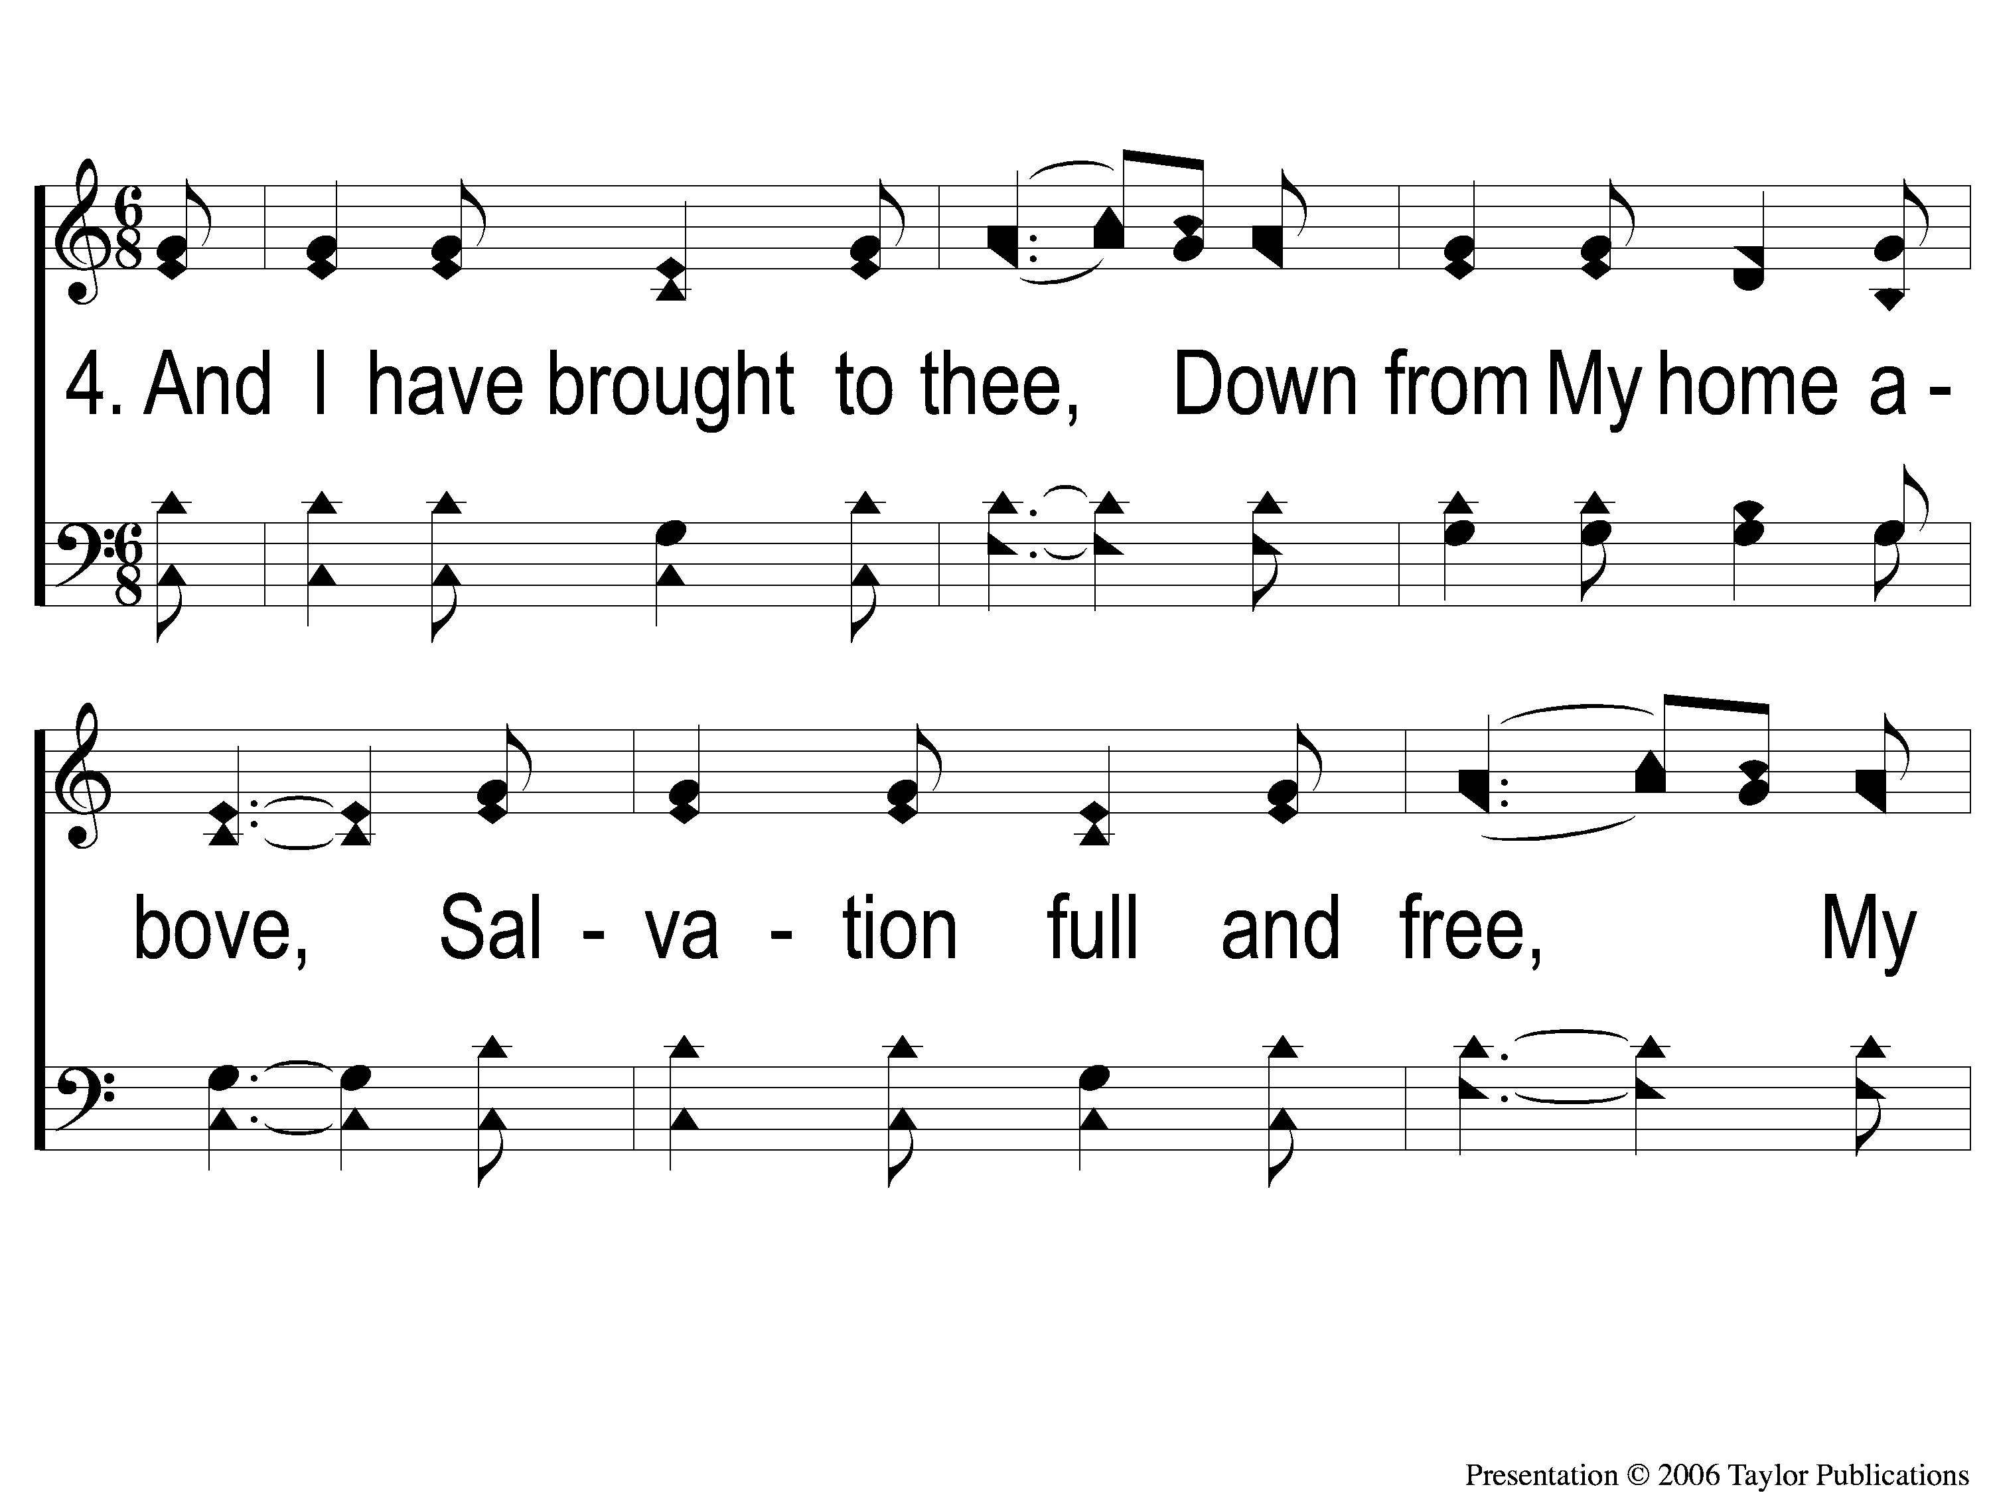
4-1 I Gave My Life For Thee
I Gave My Life for Thee
159

Slide 11
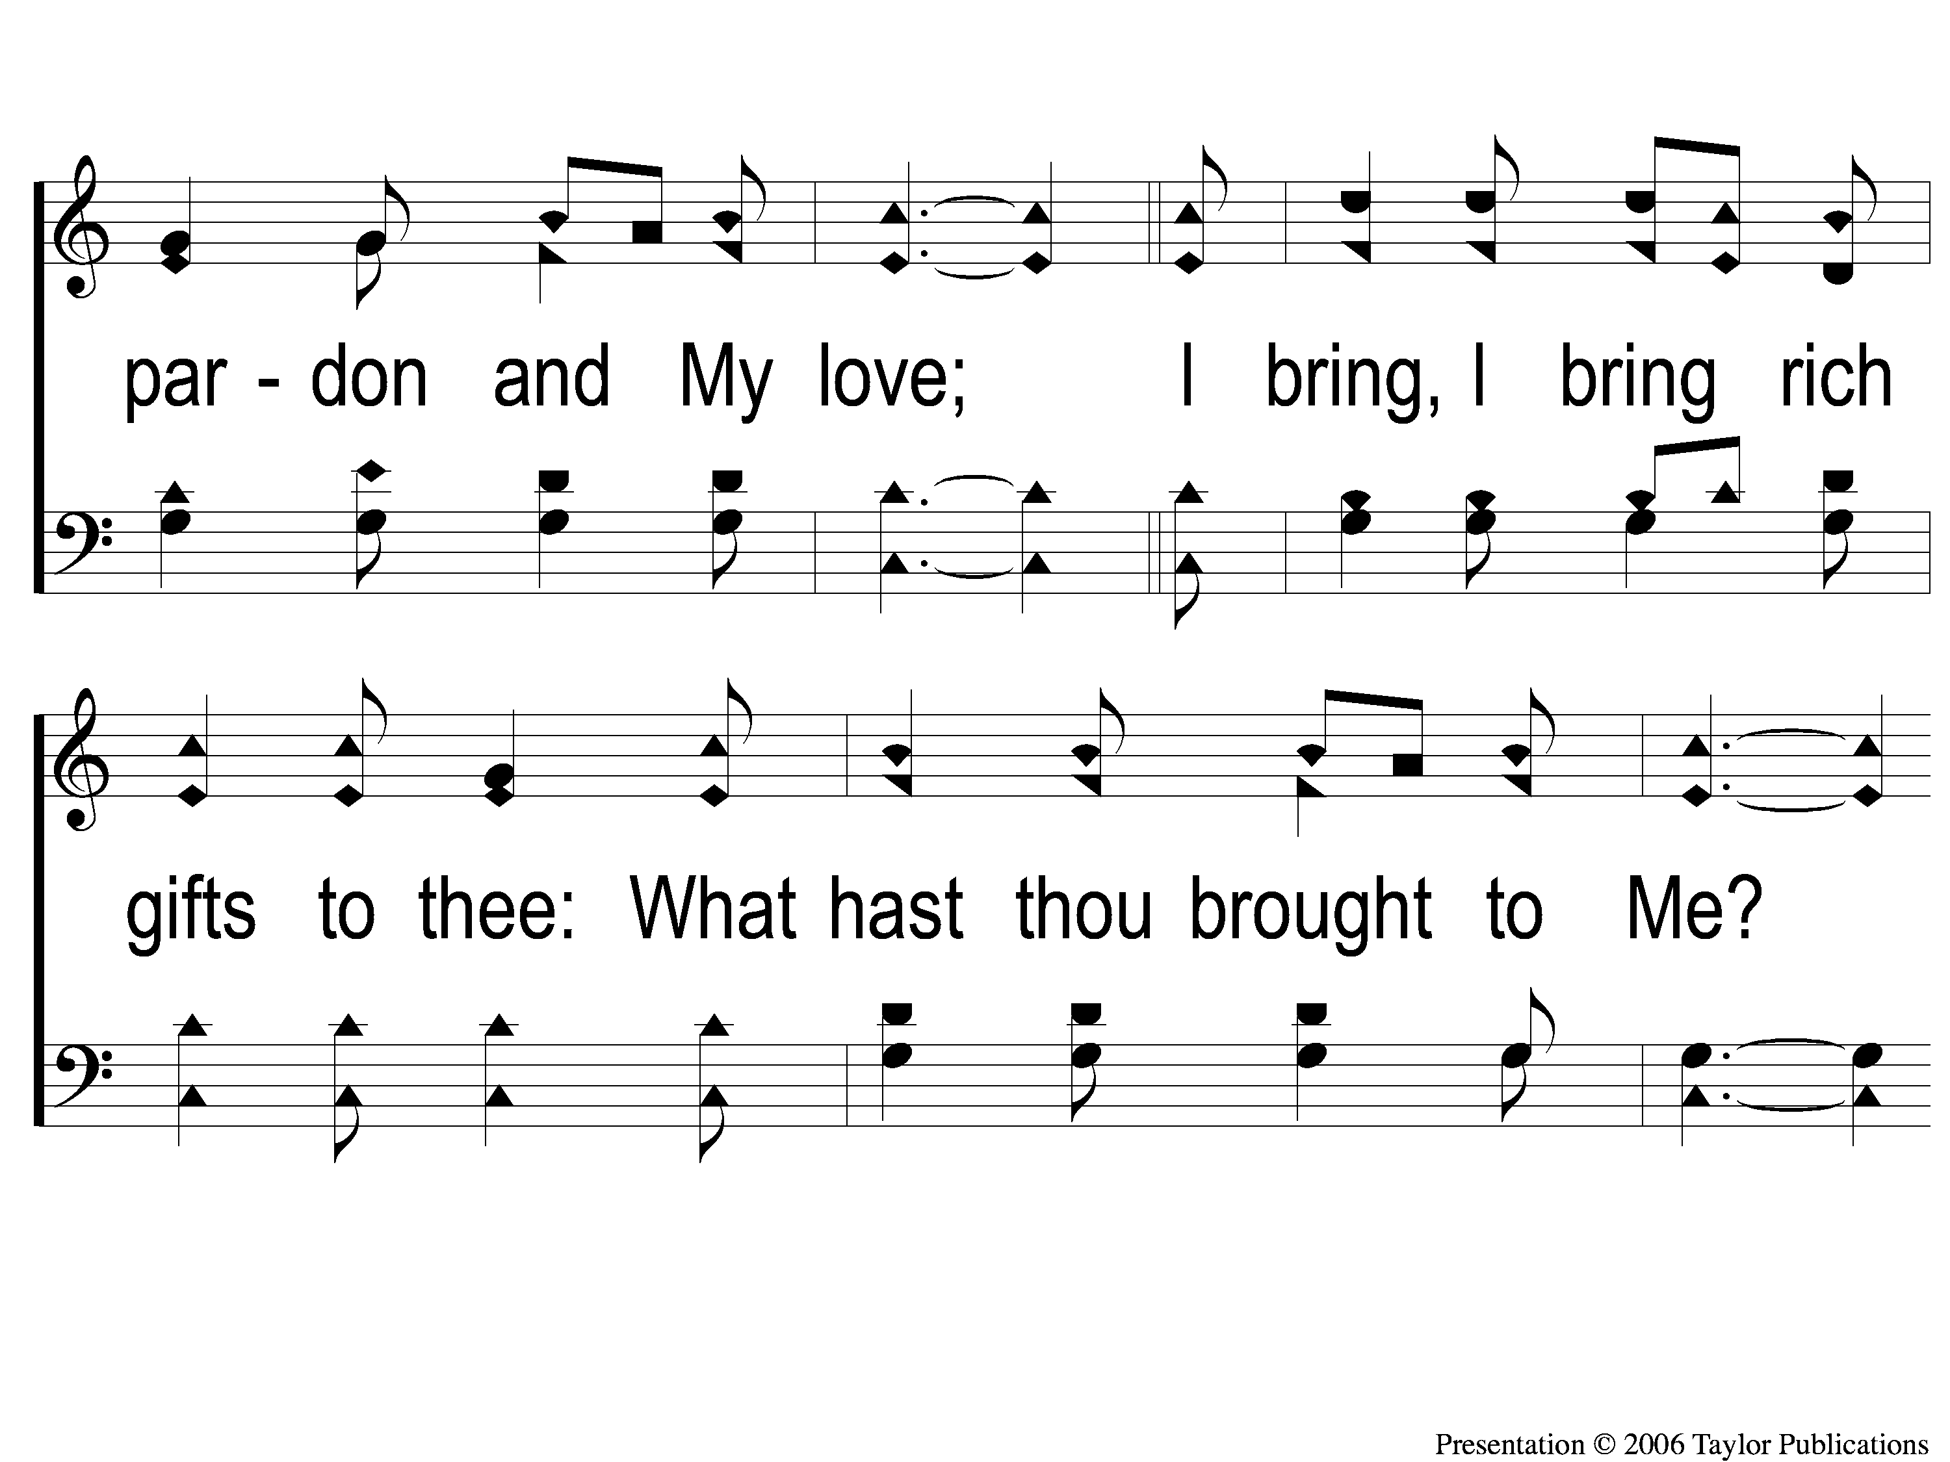
4-2 I Gave My Life For Thee
I Gave My Life for Thee
159

Slide 12
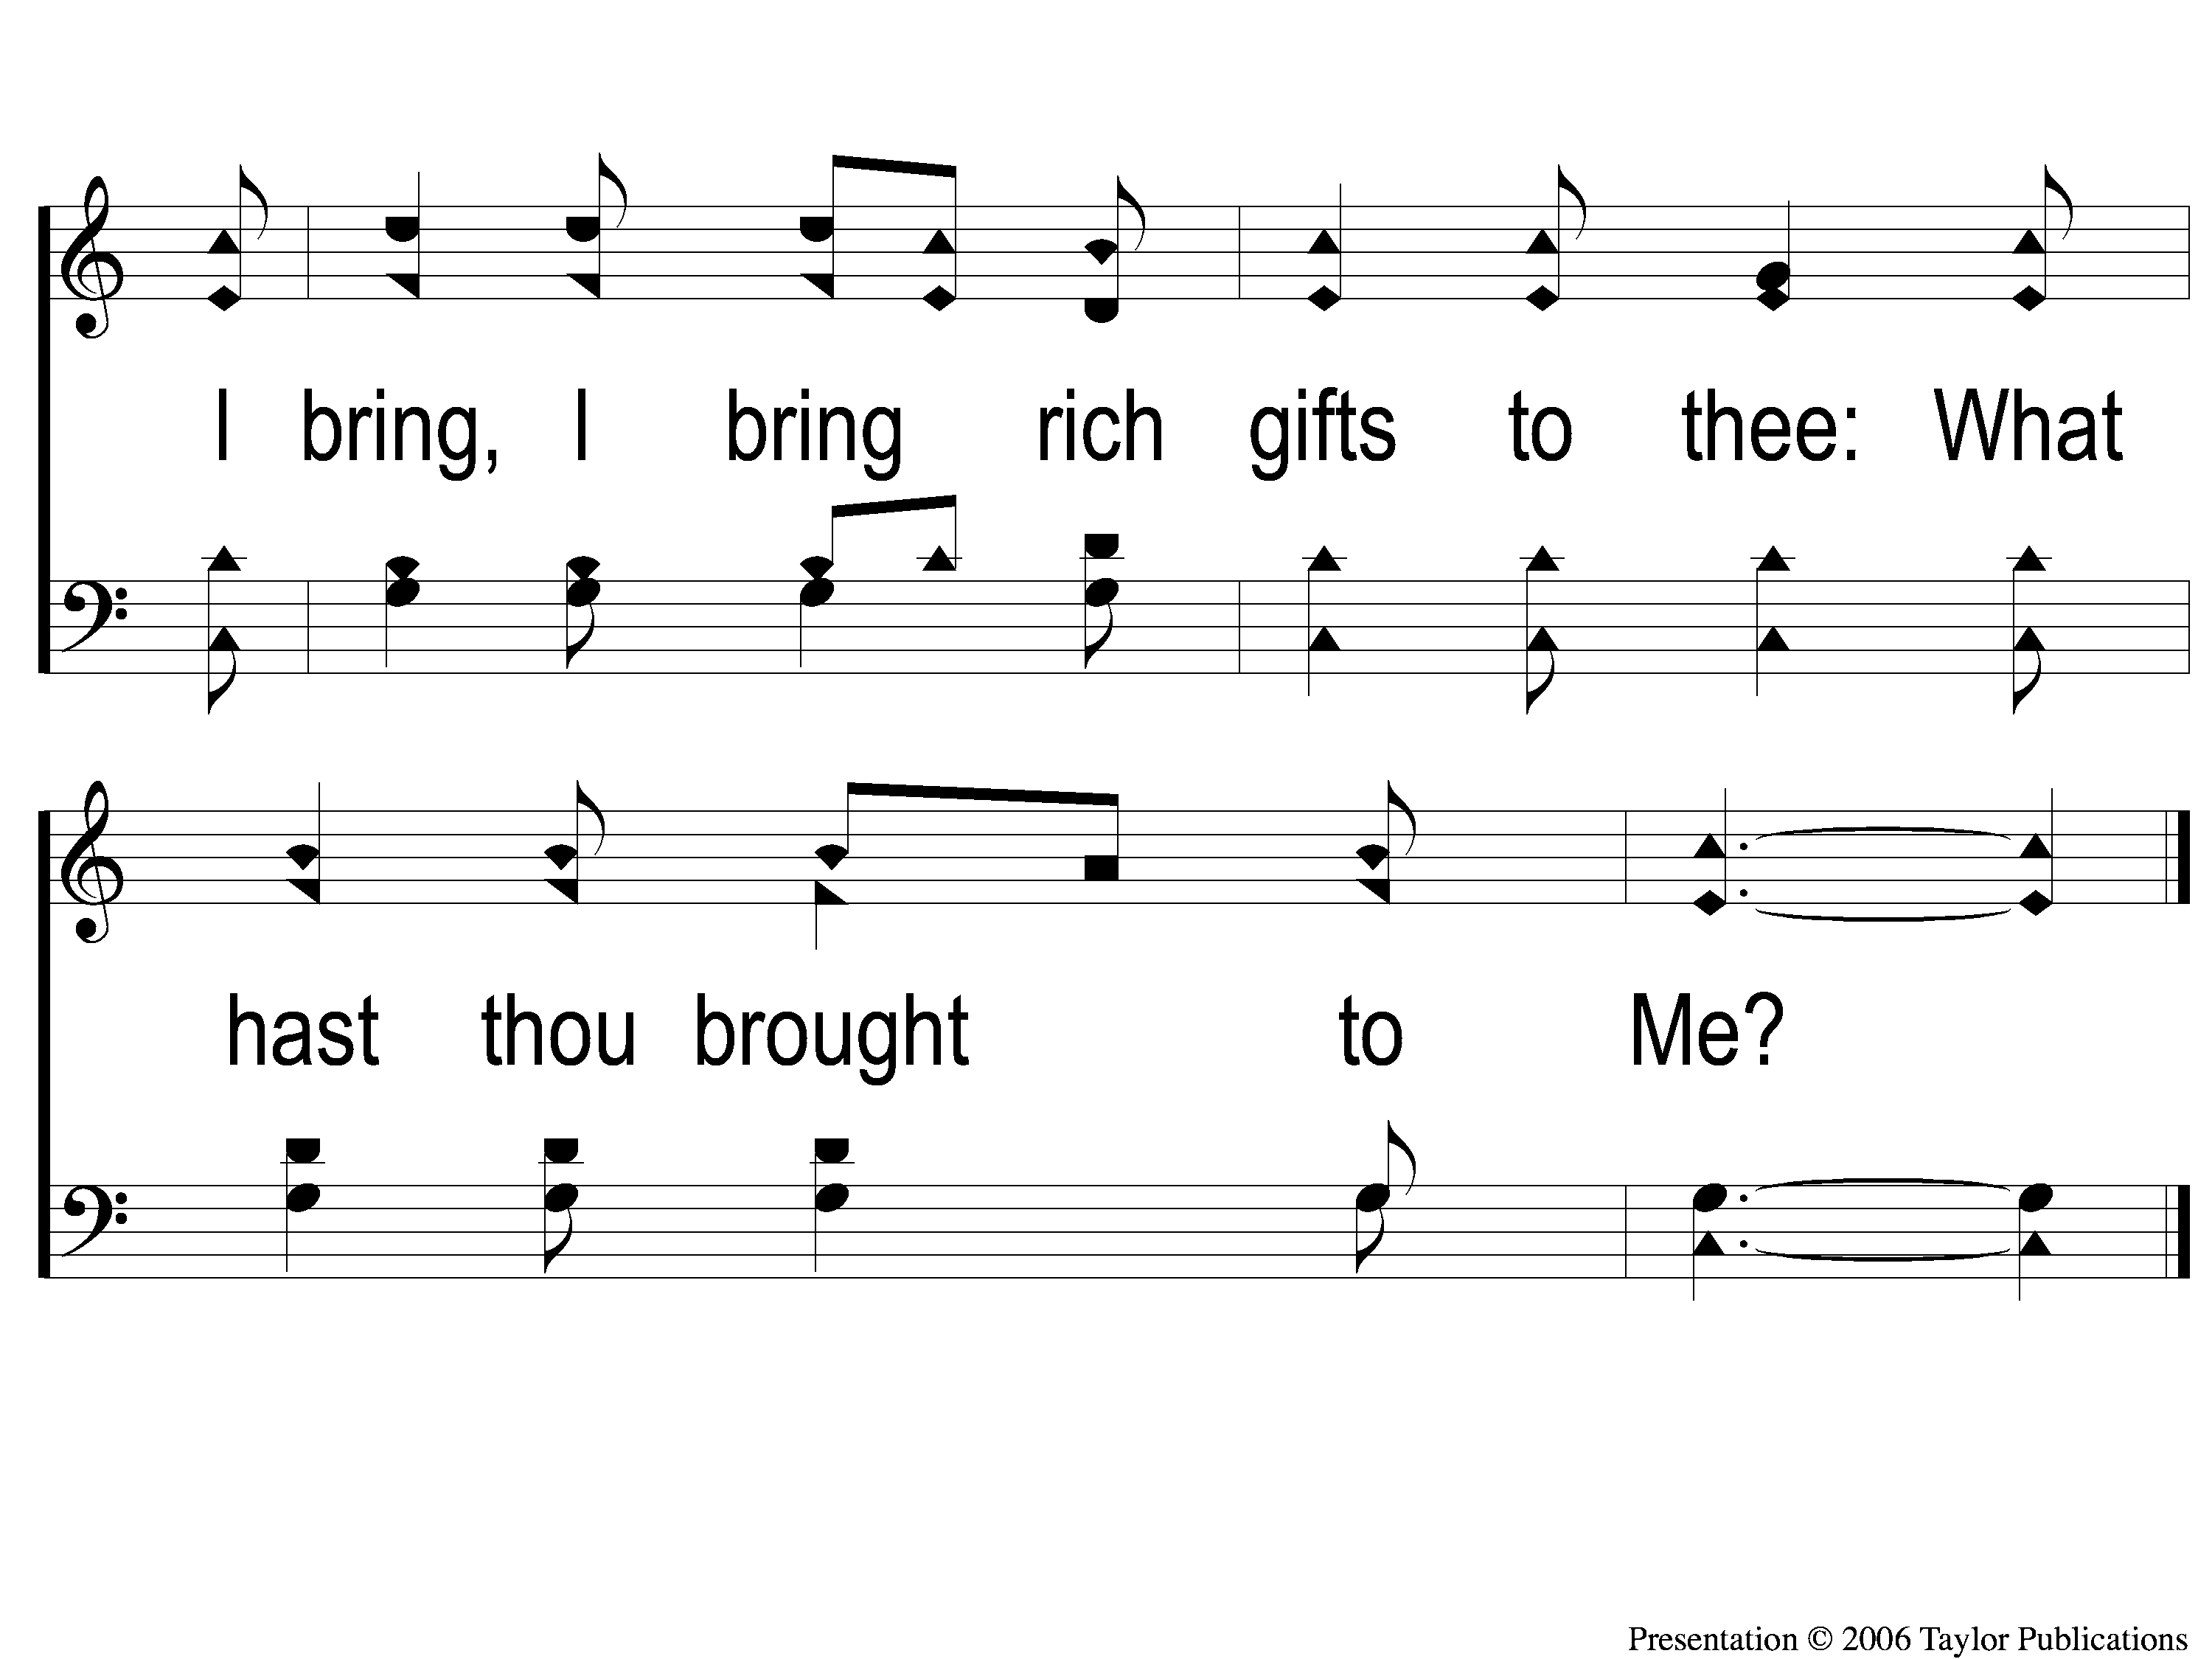
4-3 I Gave My Life For Thee
I Gave My Life for Thee
159

